Slide 1
IP Camera Security (Amcrest/Dahua)
Team 1
Abdulaziz AlMailam, Kwadwo Osafo, Karin Luna

Slide 2
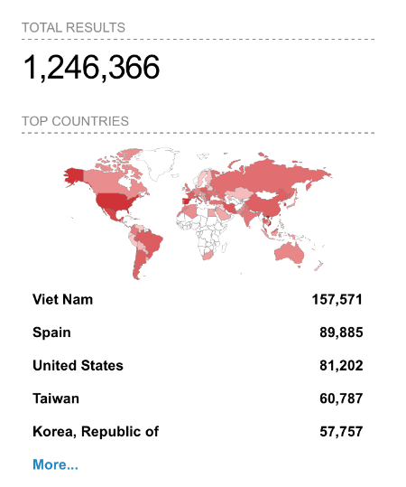
The Problem
IP Cameras widely popular, riddled with security issues
Public access to private cameras notoriously common (Shodan search for “Dahua” reveals 1.2M results)
Monopoly of camera industry (Dahua, Hikvision)
Vulnerabilities in one camera likely exist in various other cameras
Our goal is to raise awareness around the common cybersecurity issues within these cameras.
Notes:
The second point was referring to the fact that it can be very easy to obtain access to a cameras connected to the internet and attempt to gain access to it. We can talk about the shodan example here

Slide 3
Our Plan
Evaluate common vulnerabilities in a generic IP camera
In our example, we are using the Amcrest IP8M-2796EW-AI
Attempt to recreate common attacks and known exploits
Brute force login attempt
DDOS attacks
Kaminsky DNS poisoning

Slide 4
Background Info - Device Factory-Default Settings
Max Concurrent Connections: 10
TCP Port: 37777
UDP Port: 37778
HTTP Port: 80
RTSP Port: 554
HTTPS: Off (user must upload a certificate to enable)
Logging: Off
Users (both have full administrative privileges):
admin
888888

Slide 5
Background Info - Device Factory-Default Settings
Max Concurrent Connections: 10
TCP Port: 37777
UDP Port: 37778
HTTP Port: 80
RTSP Port: 554
HTTPS: Off (user must upload a certificate to enable)
Logging: Off
Users (both have full administrative privileges):
admin
888888

Slide 6
Background Info - Device Factory-Default Settings
Logging: Off
No evidence of an attack as no logs exist
Even if enabled, the logging system is often broken and can’t properly open a file to write to (most cameras don’t have local storage)
TCP Port: 37777 – Not rate-limited! More in a bit…
Users (both have full administrative privileges):
admin - default user, username/password can be changed
888888 - hidden user intended for mouse-keyboard interaction, but actually also available remote login, only the password can be changed

Slide 7
Our Process - TCP Port (background)
Authentication requests (and all other requests) to this port NOT rate limited
Notable vulnerabilities:
CVE-2013-6117: authentication can be outright bypassed
CVE-2017-6432: Dahua DVR protocol is an unencrypted, binary protocol and is vulnerable to Man-in-Middle attacks
TCP Port (37777) is a common target for many attacks
Dahua has since patched the known vulnerabilities, but more are being uncovered and they all tie back to port 37777

Slide 8
Our Process - TCP Port
Authentication requests (and all other requests) to this port NOT rate limited
Still vulnerable to a brute force attack
Would be much harder if you also had to guess the username (we known that admin can be renamed)
User 888888 already exists, just guess the password!

Slide 9
Our Process - TCP Port (cont.)
CVE-2020-5736 – Null pointer reference:
Create a special packet with a null/zero byte in a specific location and send the packet over to TCP port 37777
Leads to a null pointer exception, causing the device to crash
Camera expects the input credentials to authenticate to be valid, but they’re actually NULL and it crashes application due to the NullPointerException

Slide 10
Our Process - TCP Port (cont.)
CVE-2020-5735 – Stack-based buffer overflow:
Create a special packet with a very large value in the Protocol field
Invoke the device’s DDNS testing logic using command 0x62 and subcommand 0x04
Send the packet over to TCP port 37777
On the camera, memcpy() will write beyond the bounds of a stack buffer, causing the device to crash
Can also be used to run shellcode but much harder since the payloads must be very, very small

Slide 11
Our Process - Javascript Web Authentication
Javascript authentication script (/RPC2)
Gets user input, sanitizes it locally, then creates an MD5 hash and submits the login request
If valid, server creates a new session ID and returns it
Just like with the TCP port attacks, you can try to guess Session IDs on until you succeed
If the camera is connected to a Digital Video Recorder (DVR), you are guaranteed that one user is always logged in
The default HTTP (80) rate limit is also fairly generous
Because of limited server-side sanitization (mostly local), also vulnerable to injection attacks

Slide 12
Our Process - Timestamp Modification
CVE-2022-30564 – Timestamp modification:
Create a special HTTP request to update the device time
API handling time updates doesn’t perform any authentication/verification and simply processes the request
Can lead cameras to overwrite previous recordings
Can mess up stored feeds due to a mismatch between recording times and actual timestamps viewable on recordings

Slide 13
Our Results / Interesting Insights
Manufacturer’s of these cameras have caught up and now:
Use MD5 hashes of passwords
Allow per-user access control permissions
Allow firewall access control policies
Configurable port rate-limits (port 37777 is still NOT rate limited)
Flag usage of invalid credentials and inputs like session IDs (available only on specific products)

Slide 14
What We Learned From Our Results
IP cameras are notoriously insecure
Widespread nature of cameras makes it hard to update, hence vulnerabilities persist even after exposure
Found vulnerabilities are fixed once reported
Importance of cybersecurity awareness when using products
Rate-limiting
Sanitize all requests server-side before processing them
Authenticating all requests (re. timestamp modification)
Make all users subject to modification (888888)

Slide 15
Questions?

